Slide 1
Chapter 6 The Normal Distribution

Slide 2
Normal Distribution / Normal Curve
A bell-shaped and symmetrical theoretical distribution,
With mean, median, and mode all coinciding at its peak
With frequencies gradually decreasing at both ends of the curve

Slide 3
Normal Distribution / Normal Curve
A theoretical ideal distribution
Real-life empirical distributions never match this model perfectly
Many aspects of social life come close, and are said to be normally distributed

Slide 4
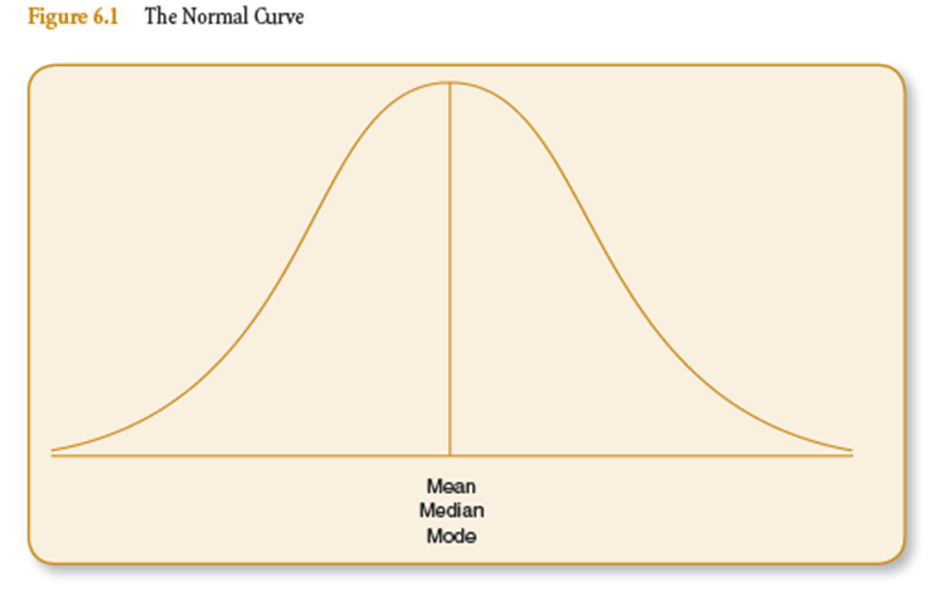
The Normal Curve

Slide 5
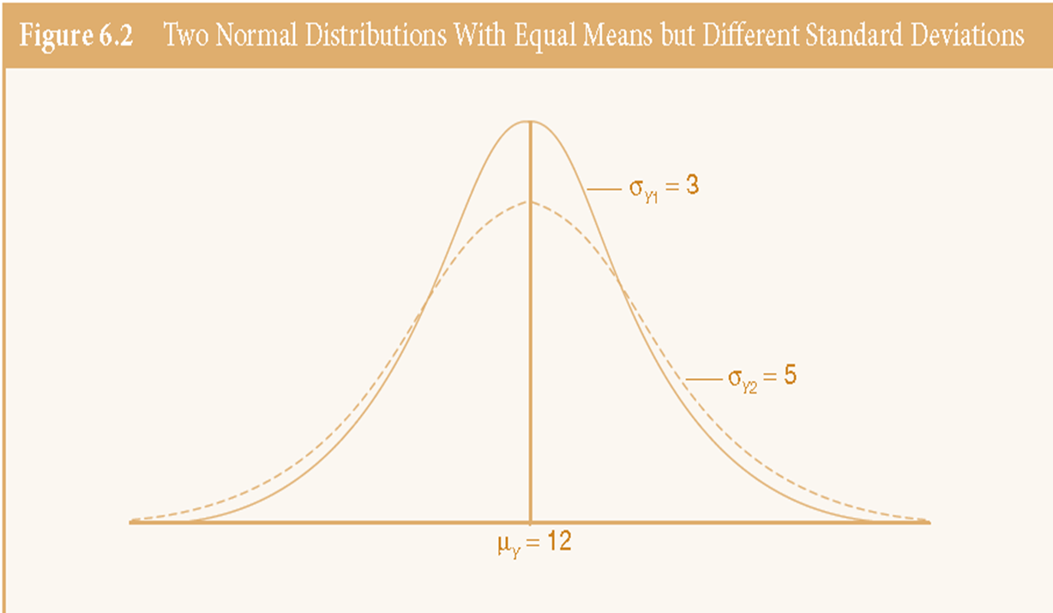
The Normal Curve

Slide 6
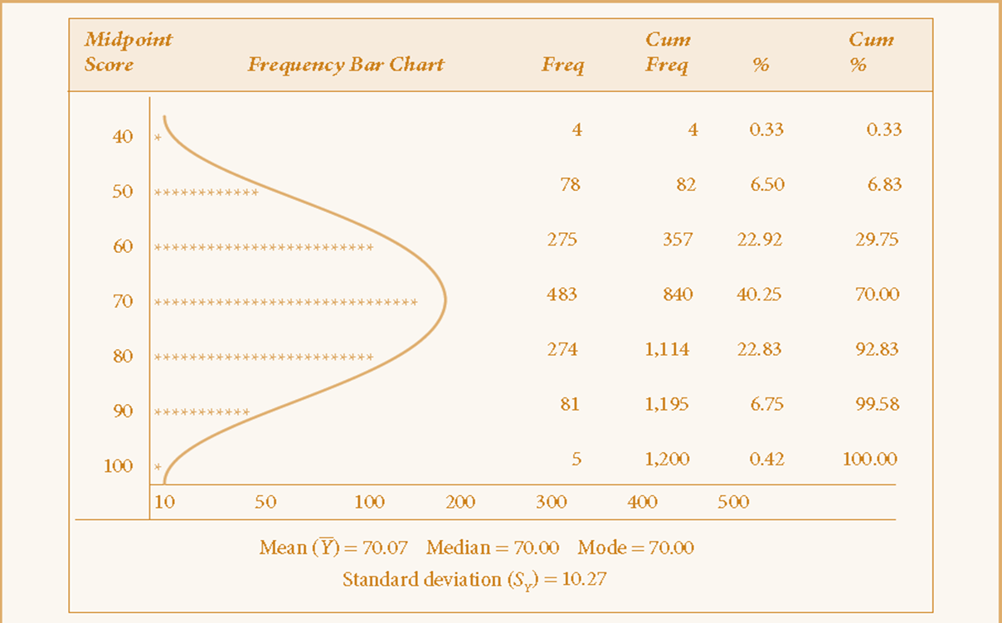
A Near Normal Distribution
Table 6.1 Final Grades in Social Statistics of 1,200 Students (1983-1993)

Slide 7
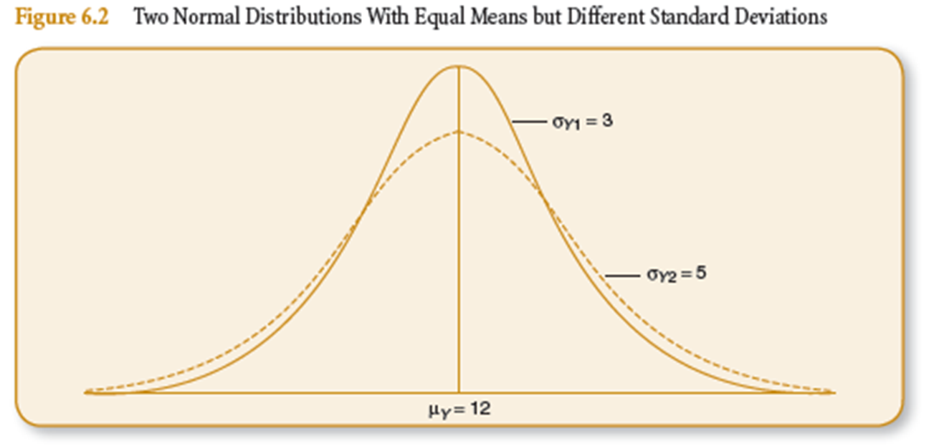
Normal Distribution
Notice that the standard deviation changes the relative width of the distribution
The larger the standard deviation, the wider the curve

Slide 8
Area Under the Normal Curve
Because the normal distribution is theoretical and never skewed, there is a constant percentage of area under the curve between any two points
Two points are measured in standard deviation units
The total area under the curve is 100%... Which represents 100% of the observations/cases (e.g. individuals, cities, states, counties, organizations)

Slide 9
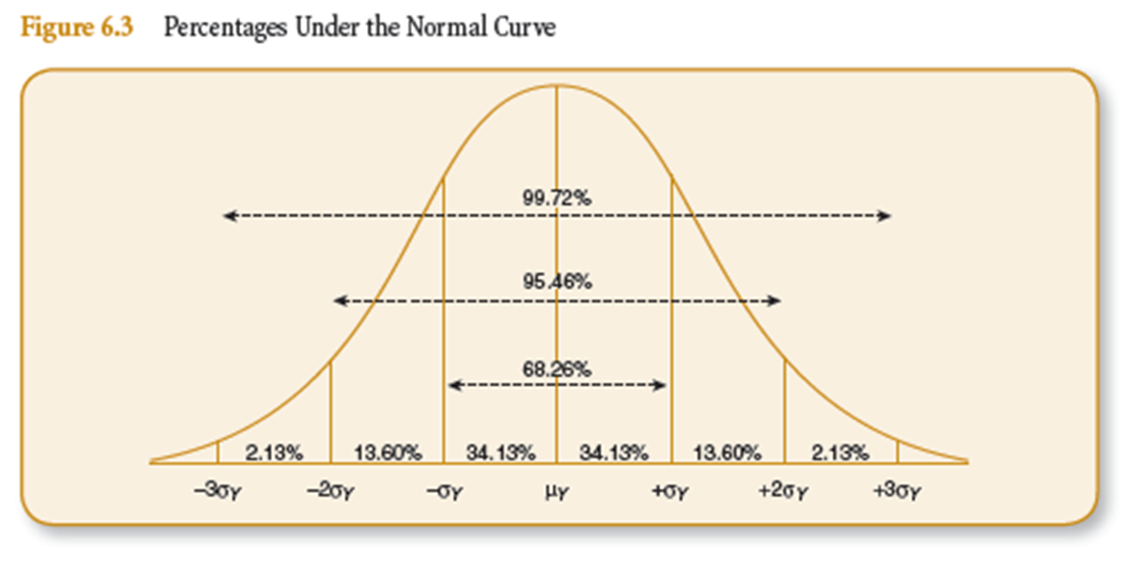
Area Under the Normal Curve

Slide 10
Exercise: Calculate Values for SAT Scores
Assume 1,000 students took the SAT and you know the following
Mean Score = 500
Standard Deviation = 100
Find the scores that coincide with:
68% of the cases (between -1SD and +1SD)
95% of the cases (between -2SD and +2SD)
99% of the cases (between -3SD and +3SD)

Slide 11
Area Under the Normal Curve
Our mean (and mode and median) is measured as 0 standard deviation units. It is the center of the distribution
50% of the area under the curve:
Lies above the mean
Lies below the mean

Slide 12
Area Under the Normal Curve
We can calculate the percentage of cases that fall between any two scores, as long as we know:
that the distribution in normal
the mean
the standard deviation

Slide 13
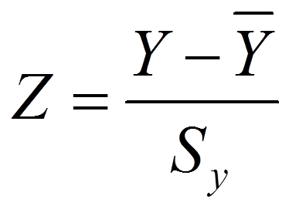
Standard (Z) Scores
The number of standard deviations that a raw score (an observation’s score) is equal to.
Can be positive (above the mean) or negative (below the mean)
We standardize to make our scores comparable
Where S_{y} = standard deviation

Slide 14
Exercise: Calculate Z Score for a Percent Grade on the Exam
Mean Score = 74%
Standard Deviation = 12%
Find the Z scores associated with:
50%
94%

Slide 15

Standard (Z) Scores
To convert a Z score back into a raw score, you need to do the following:
Where S_{y} = standard deviation

Slide 16
Standard Normal Distribution
The normal distribution using standardized (Z) scores instead of standard deviation units.
But because normal distributions all have a mean and standard deviation, you still need them
Mean = 0
SD = 1

Slide 17
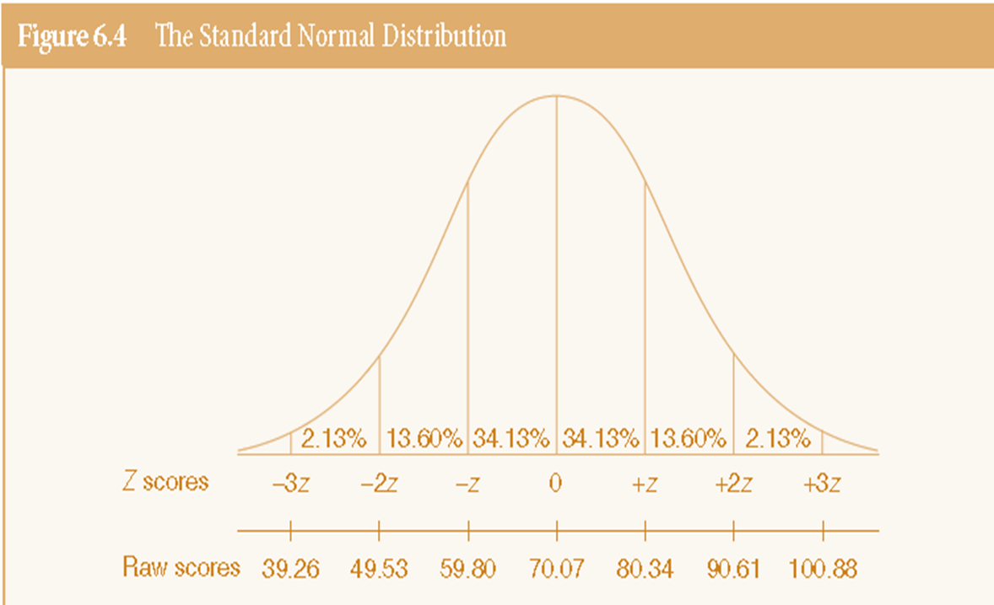
Standard Normal Distribution

Slide 18
Transforming Z scores into Proportions or Percentages
We can calculate the percent of scores that fall between two specific scores using…
The Standard Normal Table (Appendix B) pg. 480
Small portion of table on pg. 186.

Slide 19
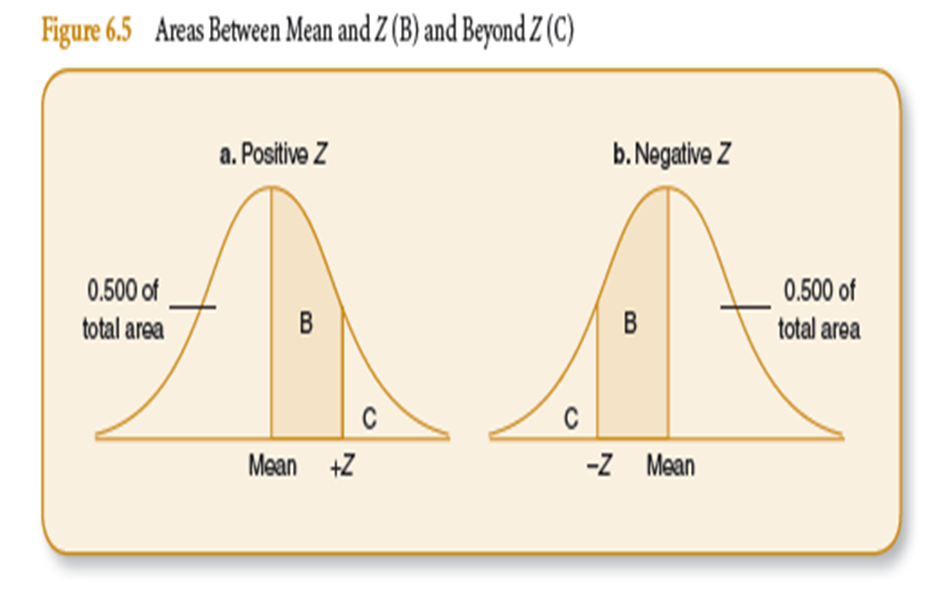
Transforming Z scores into Proportions or Percentages

Slide 20
Exercise: Finding Area Between Two Scores
Say we want to find the percent students whose final grade in a class was between 65 percent and 85 percent.
We need the lower and upper scores were interested in
We need the mean of the distribution
We need our standard deviation
We must calculate Z scores for the scores
We need our standard normal table to find the area

Slide 21
Exercise: Finding Area Between Two Scores
Say we want to find the percent students whose final grade in a class was between 65 percent and 85 percent.
Lower = 65, Upper = 85
Mean = 70.07
Standard deviation: 10.27
We must calculate Z scores for the scores
We need our standard normal table to find the area

Slide 22
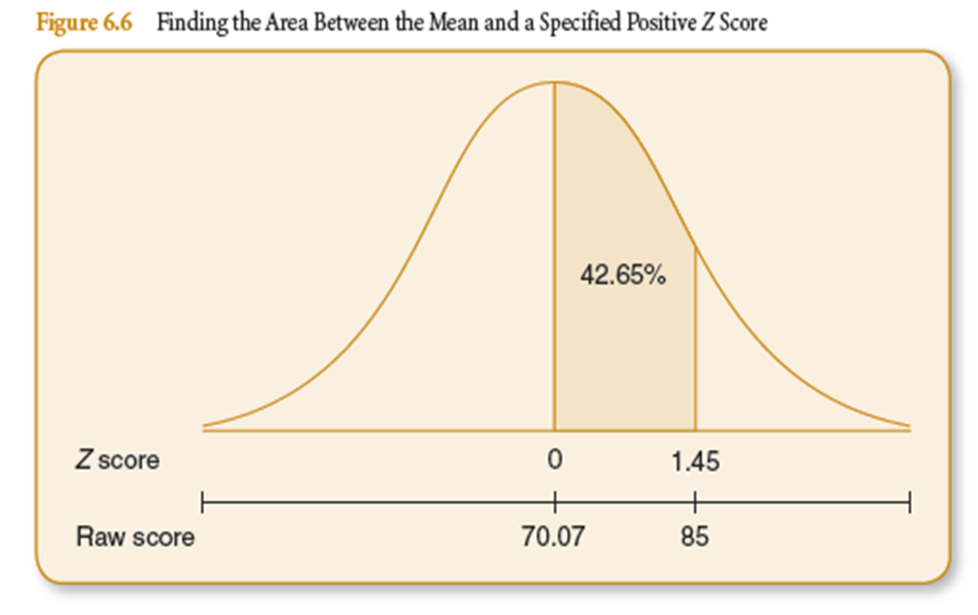
Z Scores

Slide 23
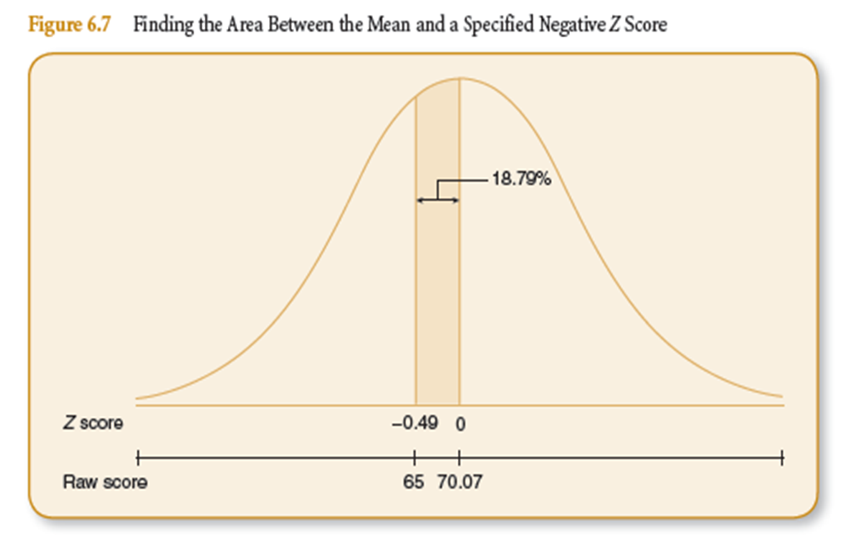
Z Scores

Slide 24
Z Scores

Slide 29
Key Terms
Normal Distribution
Standard Normal Distribution
Standard Normal Table
Standard (Z) Score

